Slide 1
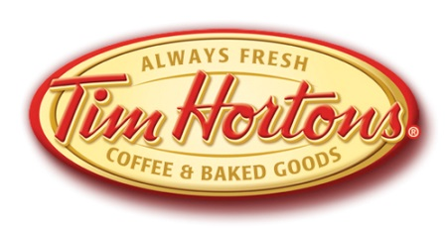
Advancing Recovery: Collaborating for New Recycling Streams
Sustainable Packaging Coalition Advance
September 10, 2014 Minneapolis, Minnesota
Notes:
Intro and Bios by Adam Gendell, SPC

Slide 2

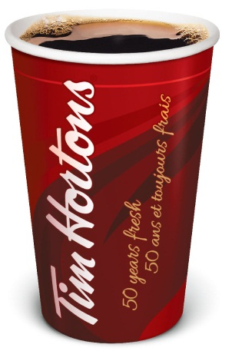
About Tim Hortons
Tim Hortons is a leader in coffee & the community
Cup recycling is an important opportunity to demonstrate leadership
Goals to increase the acceptance of hot beverage cups in restaurant and household curbside programs
Collaboration with many stakeholders is essential and will take time to see results
  Restaurants + waste service providers since 2000
  Stewardship Ontario since 2011
  Carton Council Canada in 2012
  Member of FPI - similar work in the US

Slide 3


Partners in Collaboration
Brand Owner
  Alliance of carton manufacturers working to increase carton recycling cross North America and continuously improve cartons environmental performance
Producer responsibility organization for packaging discarded in the Ontario residential recycling stream
  Financial and operational interface with Ontario programs
  Consultant and provider of product steward solutions

Slide 4
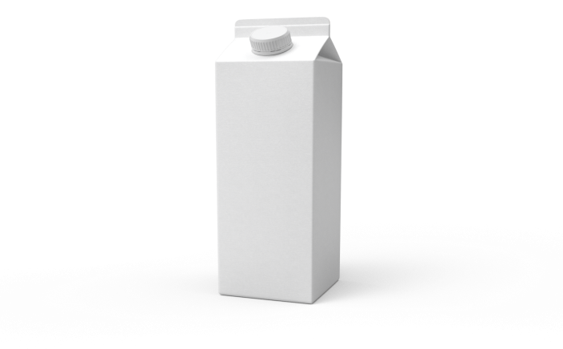
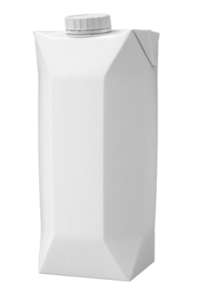

Poly-Coated Paper Packaging Background in Ontario Canada
Gable top and aseptic cartons are a common type of poly-coated paper packaging that is included in a majority of North American residential recycling programs
Other poly-coated paper packaging with similar composition is NOT typically targeted for collection
  Hot and cold cups
  Ice cream cartons
  Freezer board (frozen food-contact paperboard packaging)
Knowledge Gaps
  Sorting at MRFs – where does it and where should it flow
  (i.e., fibers vs. containers in single stream MRFs)
  Mill processability and fiber yield
    PSI Grade 52 (Aseptic and Gable Top Cartons) – “Consists of liquid packaging board containers…”
    PSI Grade 1 (Residential Mixed Paper) – “Consists of a mixture of various qualities of paper…”

Slide 5

Market Development Initiative Goals in Ontario, Canada
Explore opportunities to increase the recycling performance of post-consumer beverage paper cups and beverage cartons
  Increase recycling convenience to consumers by harmonizing what is accepted in recycling programs
  Grow volumes of material accepted in residential recycling programs
  Maximize value for MRFs to sort compatible poly-coated paper packaging into an appropriate grade
  Gauge opportunities to optimize components of the recycling value chain

Slide 6



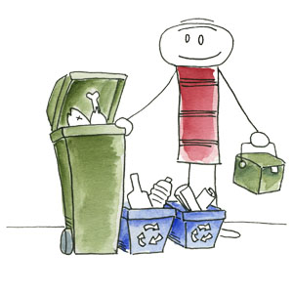
Three Phased Approach to Closing the Loop
Phase 1 began at the MRF to understand the challenges faced during material sorting
MRF
Phase 3 focuses on working to overcome technical challenges, communicating results, and partnering with a community to expand poly coated paper packaging collection
Phase 2 moved to the mill to understand the implications of expanding poly- coated paper packaging packed by MRFs
Community & Consumer
Paper Mill

Slide 7
Phase 1 Methodology – MRF Testing
Consistent test methodology, at four MRFs
  Dual stream and single stream
  Large and small sizes
  Manual and mechanical carton sorting
Material was seeded into the MRF’s incoming material, simulating pilot collection, then sorted regular operating conditions (full scale tests)
  Loading based on curbside waste audits completed in Ontario
  Included seeding other materials similar to cups – realistically considered how consumers would be told what they can recycle
Seeded material was tracked from tip floor to bunker to understand material flow
MRF

Slide 8
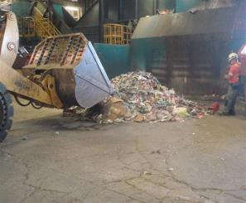
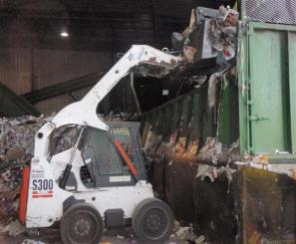
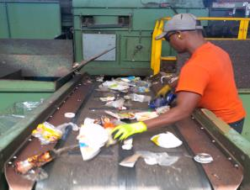
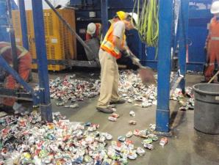
Phase 1 – Test Photographs
Mixing Material
Loading Material
MRF
Seeded material was mixed into background mixed recyclables.
Material was loaded into the MRF replicating regular operations.
Running Tests
Sorting Material
Manual sorters given instruction prior to testing in regards to target material.
Auditors sorted through all bunkers to gather seeded material.

Slide 9
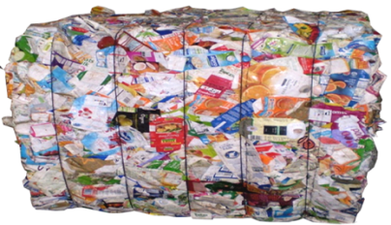
Phase 1 – MRF Lessons Learned
Cups and ice cream cartons followed the same flow paths as cartons in single stream MRFs
Optical sorters for aseptic and gable top cartons were not always effective in sorting hot drink cups and ice cream cartons
  Special calibration of one MRF’s optical sorter for other poly-coated paper package types provided good results
Poly-coated paper packaging other than cups/ice cream went elsewhere
  Two-dimensional coated paper packaging went with paper (in single stream MRFs)
  Spiral wound canisters with steel ends went with steel
MRF

Slide 10
Phase 2 Methodology – Mill Testing
Conducted full-scale market testing at one
existing mill that batch recycles PSI-52 grade cartons
  Test 1 – cartons only (PSI-52 grade as a control)
  Test 2 – cartons and cups only
  Test 3 – cartons, cups, and ice cream cartons
Other poly-coated paper products were seeded into carton bales, all from one MRF, for tests 2 and 3
  Pre-consumer cups – two hot cup varieties and 1 cold cup type
  Post-consumer ice cream cartons
  Concentrations were based on generation rates, residential capture rates, and Phase 1 MRF sorting effectiveness rates
Full batches were processed and mill metrics recorded
Paper Mill

Slide 11
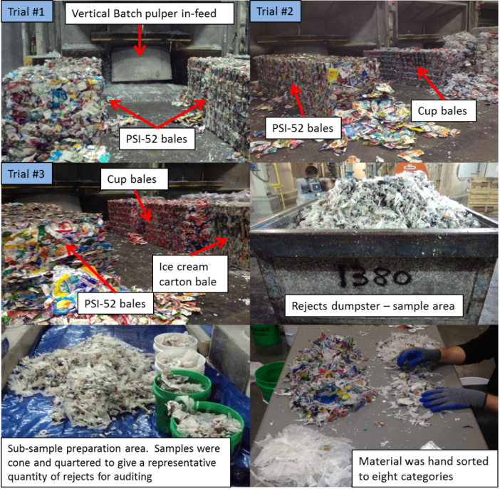
Phase 2 – Test Photographs
Paper Mill

Slide 12
Phase 2 – Mill Lessons Learned
The addition of cups in trial (#2) provided
comparable fiber yield and pulp quality results at this mill compared to the cartons-only trial (#1)
Fiber yield in trial #3 (cups and ice cream added to cartons) was much lower than trials 1 and 2
  Effect was greater than amount of ice cream cartons in trial
  Also some cup variability between trials 2 and 3
  Additional testing of ice cream cartons is needed
Paper Mill

Slide 13
Next Steps
Work with a cooperative MRF for the pilot, including manual and optical sorter adjustments
MRF
Phase 3 Work to overcome technical challenges then partner with an Ontario community to successfully collect and recycle compatible poly-coated paper packaging while assessing infrastructure needs, communications, and costs and benefits
Continue mill evaluations to understand the implications of expanding poly-coated packaging recycling
Community & Consumer
Paper Mill

Slide 14
Concluding Comments
  Research is focused in Ontario, Canada, which differs from the United States in certain key aspects
    Generation differences for cartons, cups, and ice cream
    Framework for producer participation in recycling systems
Commitment to partnership and collaboration, will allow for obstacles to be identified and overcome in a concerted manner and may result in the recycling of new materials
Everyone in the supply and recycling chains must be aligned for success – this includes MRF equipment and sorting practices, mill processing conditions as well as items such as product design and consumer engagement
  There is no change to the market specification for PSI Grade 52
    This market development project is still at an early stage
    Individual mills differ in their equipment and ability to recycle poly-coated paper packaging beyond beverage cartons

Slide 15

Carol Patterson
Director, Government & Environmental Affairs
Tim Hortons Inc.
Direct: +1 905.339.5918
patterson_carol@timhortons.com
Tim Buwalda
Senior Consultant
Reclay StewardEdge
Direct: +1 407.756.7220
tbuwalda@reclaystewardedge.com

